Slide 1

Course Project 1: Covid-19 Cases Prediction
Hands on Artificial Intelligence and Robotics
Lingxiao Wang, Ph.D.
Assistant Professor of Electrical Engineering
Louisiana Tech University

Slide 2
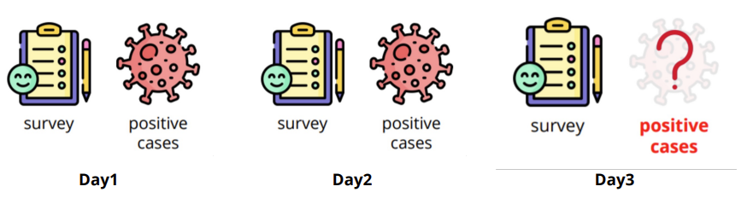
Course Project 1: COVID-19 Cases Prediction
Objectives:
Solve a regression problem with deep neural networks (DNNs)
Understand basic DNN training tips
Get familiar with PyTorch
Task Description: COVID-19 Cases Prediction
Given survey results in the past 4 days, then predict the percentage of new tested positive cases in the 5th day.
The data is obtained from a daily survey from April 2020 to August 2020, conducted by CMU.
…
Day5

Slide 3
Course Project 1: COVID-19 Cases Prediction
Data contains:
US States (37, encoded to one-hot vectors)
One hot-vector contains only one element equals to 1 while others are 0.
COVID-like illness (4)
Chill (cli), Running nose (ili), fever, …
Behavior Indicators (8)
Wearing_mask, shop_indoors, restaurant_indoors,…
Mental health indicator (3)
Worried_catch_covid, worried_finance, …
Tested Positive Numbers (1)
Tested positive cases (this is what we want to predict)

Slide 4
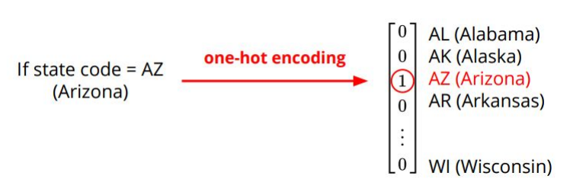
One-hot Vector
One-hot vector is a vector with only one element equals to 1 while others are 0.
This type of vector is usually used to encode discrete values.

Slide 5
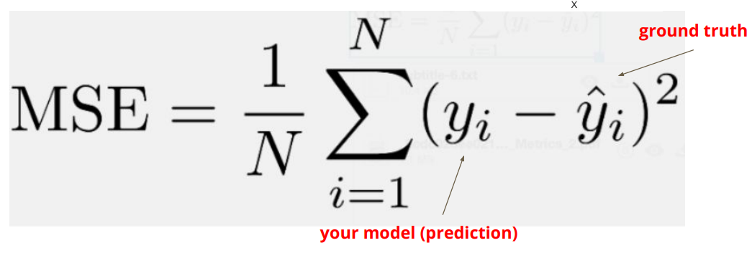
Evaluation Metric
Evaluation metric:
Mean square error

Slide 6
Pytorch Tensor
Pytorch Tensor Tutorial
Link:
https://colab.research.google.com/drive/18ShX7ox6AqfKwGhPwrGnEeaLk89Zjfjl?usp=sharing
Pytorch Network Tutorial
Link:
https://colab.research.google.com/drive/1O9Mqtq-cFmgxRcIDBlSOpaeC3eJxjLRD?usp=sharing

Slide 7
Schocastic gradient descent (SGD)
Schocastic gradient descent (SGD) – Optimization Method
Divide the training data into batches
Choose small batch numbers
A very large batch may cause even a single iteration to take a very long time to compute
SGD uses only a single example (i.e., a batch size of 1) per iteration.
If the training data contains 100 examples, SGD updates the model 100 times.
The term stochastic indicates that one example comprising each batch is chosen at random.

Slide 8
Training Dataset vs Validation Dataset
Training set:
This is the largest part in terms of the size of the dataset.
The training set is used to train (fit) the model.
The model parameters learn their values (rules or patterns) from training data.
Validation set:
Our model training process is not a one-time process.
We have to train multiple models by trying different combinations of hyperparameters. Then, we evaluate the performance of each model on the validation set.
Therefore, the validation test is useful for hyperparameter tuning or selecting the best model out of different models.
Small loss on both training and validation set -> Good model

Slide 9
Colab Sample Code
Link to colab:
https://colab.research.google.com/drive/1oIqNn8QkC6SpL2ZRypYNLw1toi1NeS37?usp=sharing

